Slide 1
EM Spectrum
Spectra
Blackbodies + Wien’s Law
Spectroscopy
Spectral Types
Luminosity and the inverse square law
Variation in Luminosity
Notes:
SUMMARY
Strong theory focus.
Little math although Wien’s law, and the luminosity-brightness relationship are given.

Slide 2
Solar Radiation
and Habitable Zones
Notes:
TITLE
Use this slide to briefly introduce the topic of today’s lesson.

Slide 3
Recap
Name as many layers of the Sun. Deepest first.
Name three features on the Sun’s surface.
What can we only observe during a solar eclipse?
Notes:
RECAP
Spend 4-5 minutes recapping the last lesson (Solar Structure). Have students answer the questions in TPS format.
Answers on next slide
Answers on next slide
The Corona

Slide 4
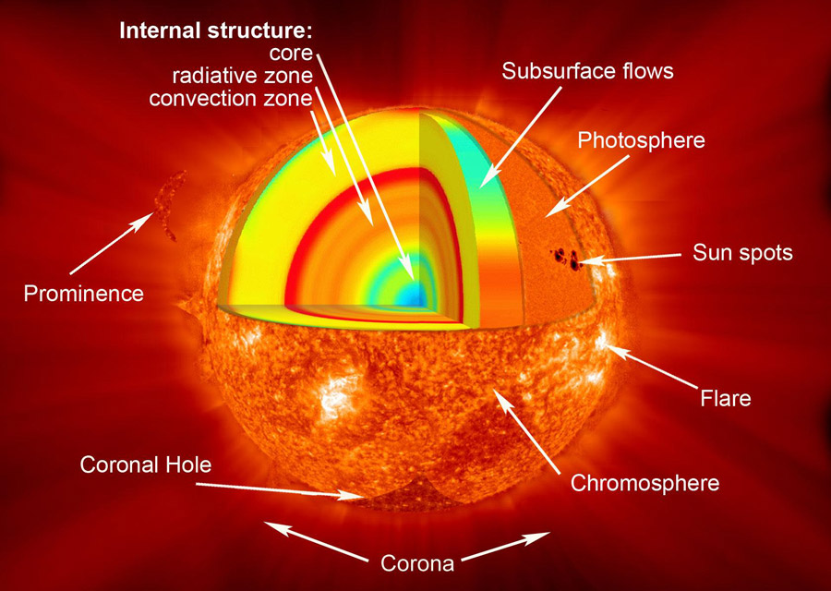
Solar Structure
SOHO/NASA/ESA
Notes:
PRESENTATION NOTES
Students should remember the granular surface structure
Quick recap
SCIENCE NOTES
Photosphere is where light comes from
Chromosphere is the layer of the atmosphere above the photosphere
Subsurface flows of gas away from the equator to the poles (diff rotation from last lessons)
Image from UCAR: https://scied.ucar.edu/sun-features-regions

Slide 5
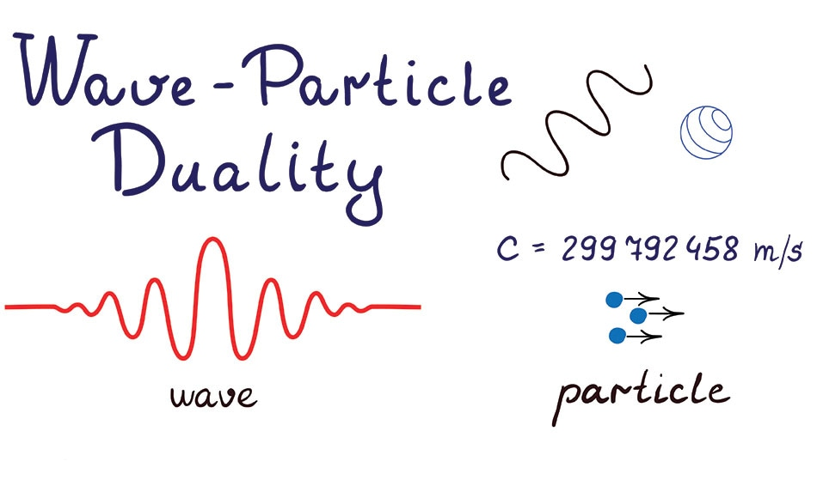
AveNa / Shutterstock
Notes:
PRESENTATION NOTES
Very quick slide – what do you know about light?
Maybe ask the question before showing this slide
SCIENCE NOTES
Particle of light is a photon
Image from: https://www.azoquantum.com/Article.aspx?ArticleID=146

Slide 6
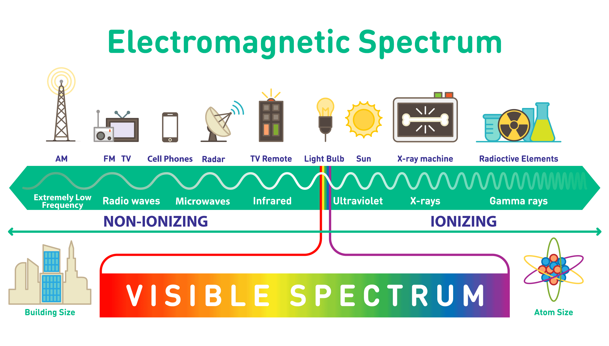
Medium.com
Notes:
PRESENTATION NOTES
Recap the EM spectrum
Can students remember the wavelengths for visible light?
SCIENCE NOTES
Ionising – Can damage DNA UV and higher frequencies only (so not 5G!)
Image from: https://medium.com/@tajamulfayaz621/electromagnetic-spectrum-b80002a65665

Slide 7
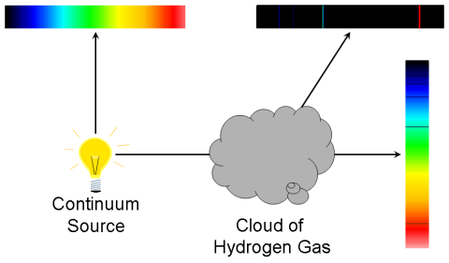
Spectra
There are three types of spectra shown here:
Continuous
Emission
Absorption
R Pogge
Notes:
PRESENTATION NOTES
It is important that students understand the difference between the three types of spectra!
We often as astronomers look at clouds of Hydrogen gas.
SCIENCE NOTES
The three types are listed clockwise starting top right with the continuous spectrum.
Image from: http://www.astronomy.ohio-state.edu/~thompson/161/spectra.html
http://www.astronomy.ohio-state.edu/~pogge/Ast162/copyright.html

Slide 8
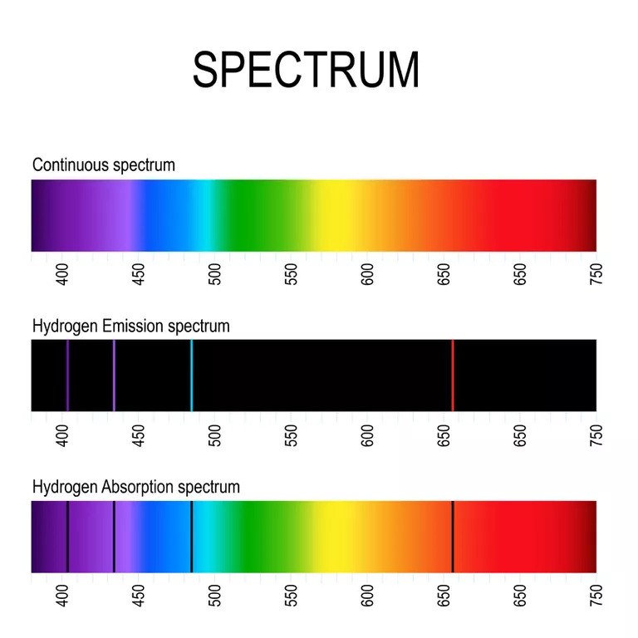
ttsz / Getty
Notes:
PRESENTATION NOTES
Don’t labour on this – just an example.
SCIENCE NOTES
The two purple lines are hard to see being on the edge of visible/UV.
The main emission line is the red H-alpha line which we try to image on its own when searching for Hydrogen.
The blue line is the H-beta emission line
Image from: https://www.thoughtco.com/definition-of-balmer-series-604381

Slide 9
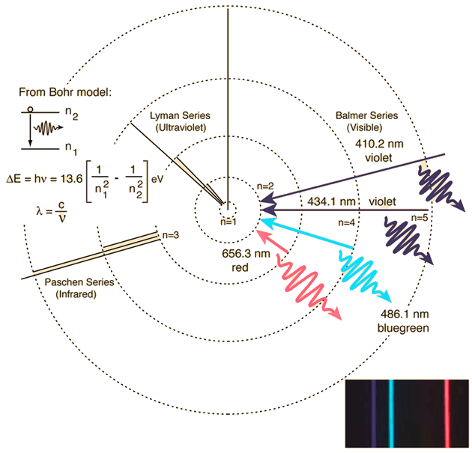
Spectra
This shows the energy levels of Hydrogen.
The Balmer Series on the right is the visible light emission.
R Nave
Notes:
PRESENTATION NOTES
Depending on the level of your students skip.
Focus on the right hand side since it links to the previous slide.
SCIENCE NOTES
Electrons can only occupy certain energy levels! This is due to the quantisation of energy.
The equation on the left is how to calculate the energy from a transition from the energy level n1 to n2.
Image from: http://hyperphysics.phy-astr.gsu.edu/hbase/hyde.html#c4

Slide 10
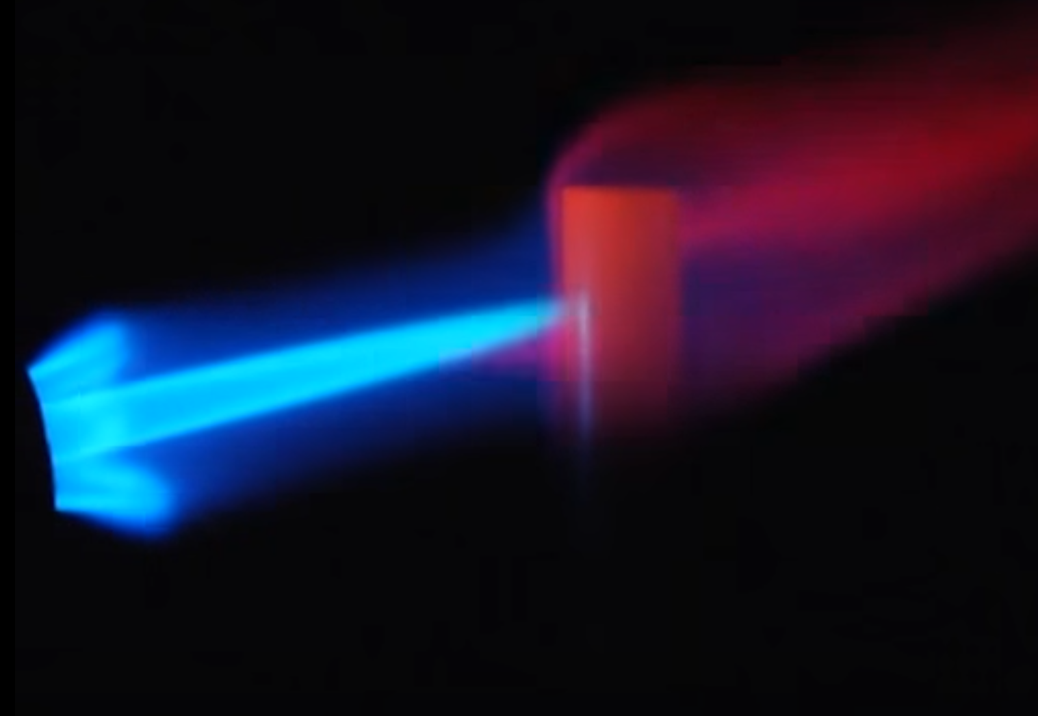
Generating Light
Light can be generated by:
Charges that are accelerating
Heating an object up (Thermal Radiation)
Fusion
R Pogge
Notes:
PRESENTATION NOTES
We are focusing on Thermal Radiation.
Load the video and narrate- it shows an IR camera and what happens in visible if you heat a metal rod with a blowtorch.
https://www.youtube.com/watch?v=sUp_WZKZID4
SCIENCE NOTES
The orangey flame is due to the surface of the metal reacting with the air around it.
Image from video: https://www.youtube.com/watch?v=sUp_WZKZID4

Slide 11
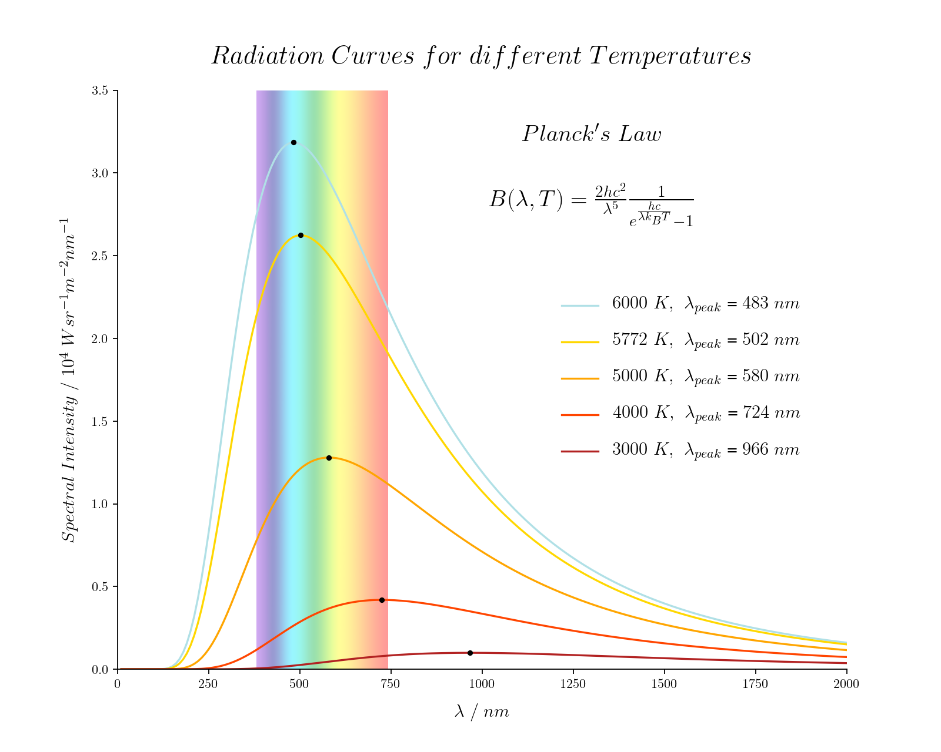
Blackbody Radiation
A blackbody absorbs all incident radiation and emits all radiation perfectly.
No real object is a perfect blackbody.
Notes:
PRESENTATION NOTES
The second tallest curve is for our Sun.
We approximate the Sun as a blackbody to do calculations.
If we get the spectrum of a star and fit a curve to it we can get the surface temp (more later).
SCIENCE NOTES
Our Sun has a peak in the blue/green wavelengths but it emits more yellows/reds since it doesn’t tail off very fast (whereas the blue side it drops fast).
So overall our Sun looks yellow.
The intensity of each wavelength is given in Watts per steradian (a 3D solid angle) per metre squared per nanometre.
Image by Dimitrios Theodorakis

Slide 12
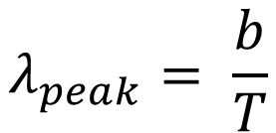
Wien’s Law
A hotter object emits more high energy radiation.
We can find the wavelength the object emits most using Wien’s Law.
$$λ_{peak}= \frac{b}{T}$$
Notes:
PRESENTATION NOTES
The hotter an object is the further left towards higher energy wavelengths we shift.
So Hotter = Higher Energy, glows whiter.
SCIENCE NOTES
b ≈ 2898 μm⋅K, b is Wien’s displacement constant
Planck’s law gives the spectral intensity (brightness B) for each wavelength and was used to construct this figure.
Image by Dimitrios Theodorakis

Slide 13
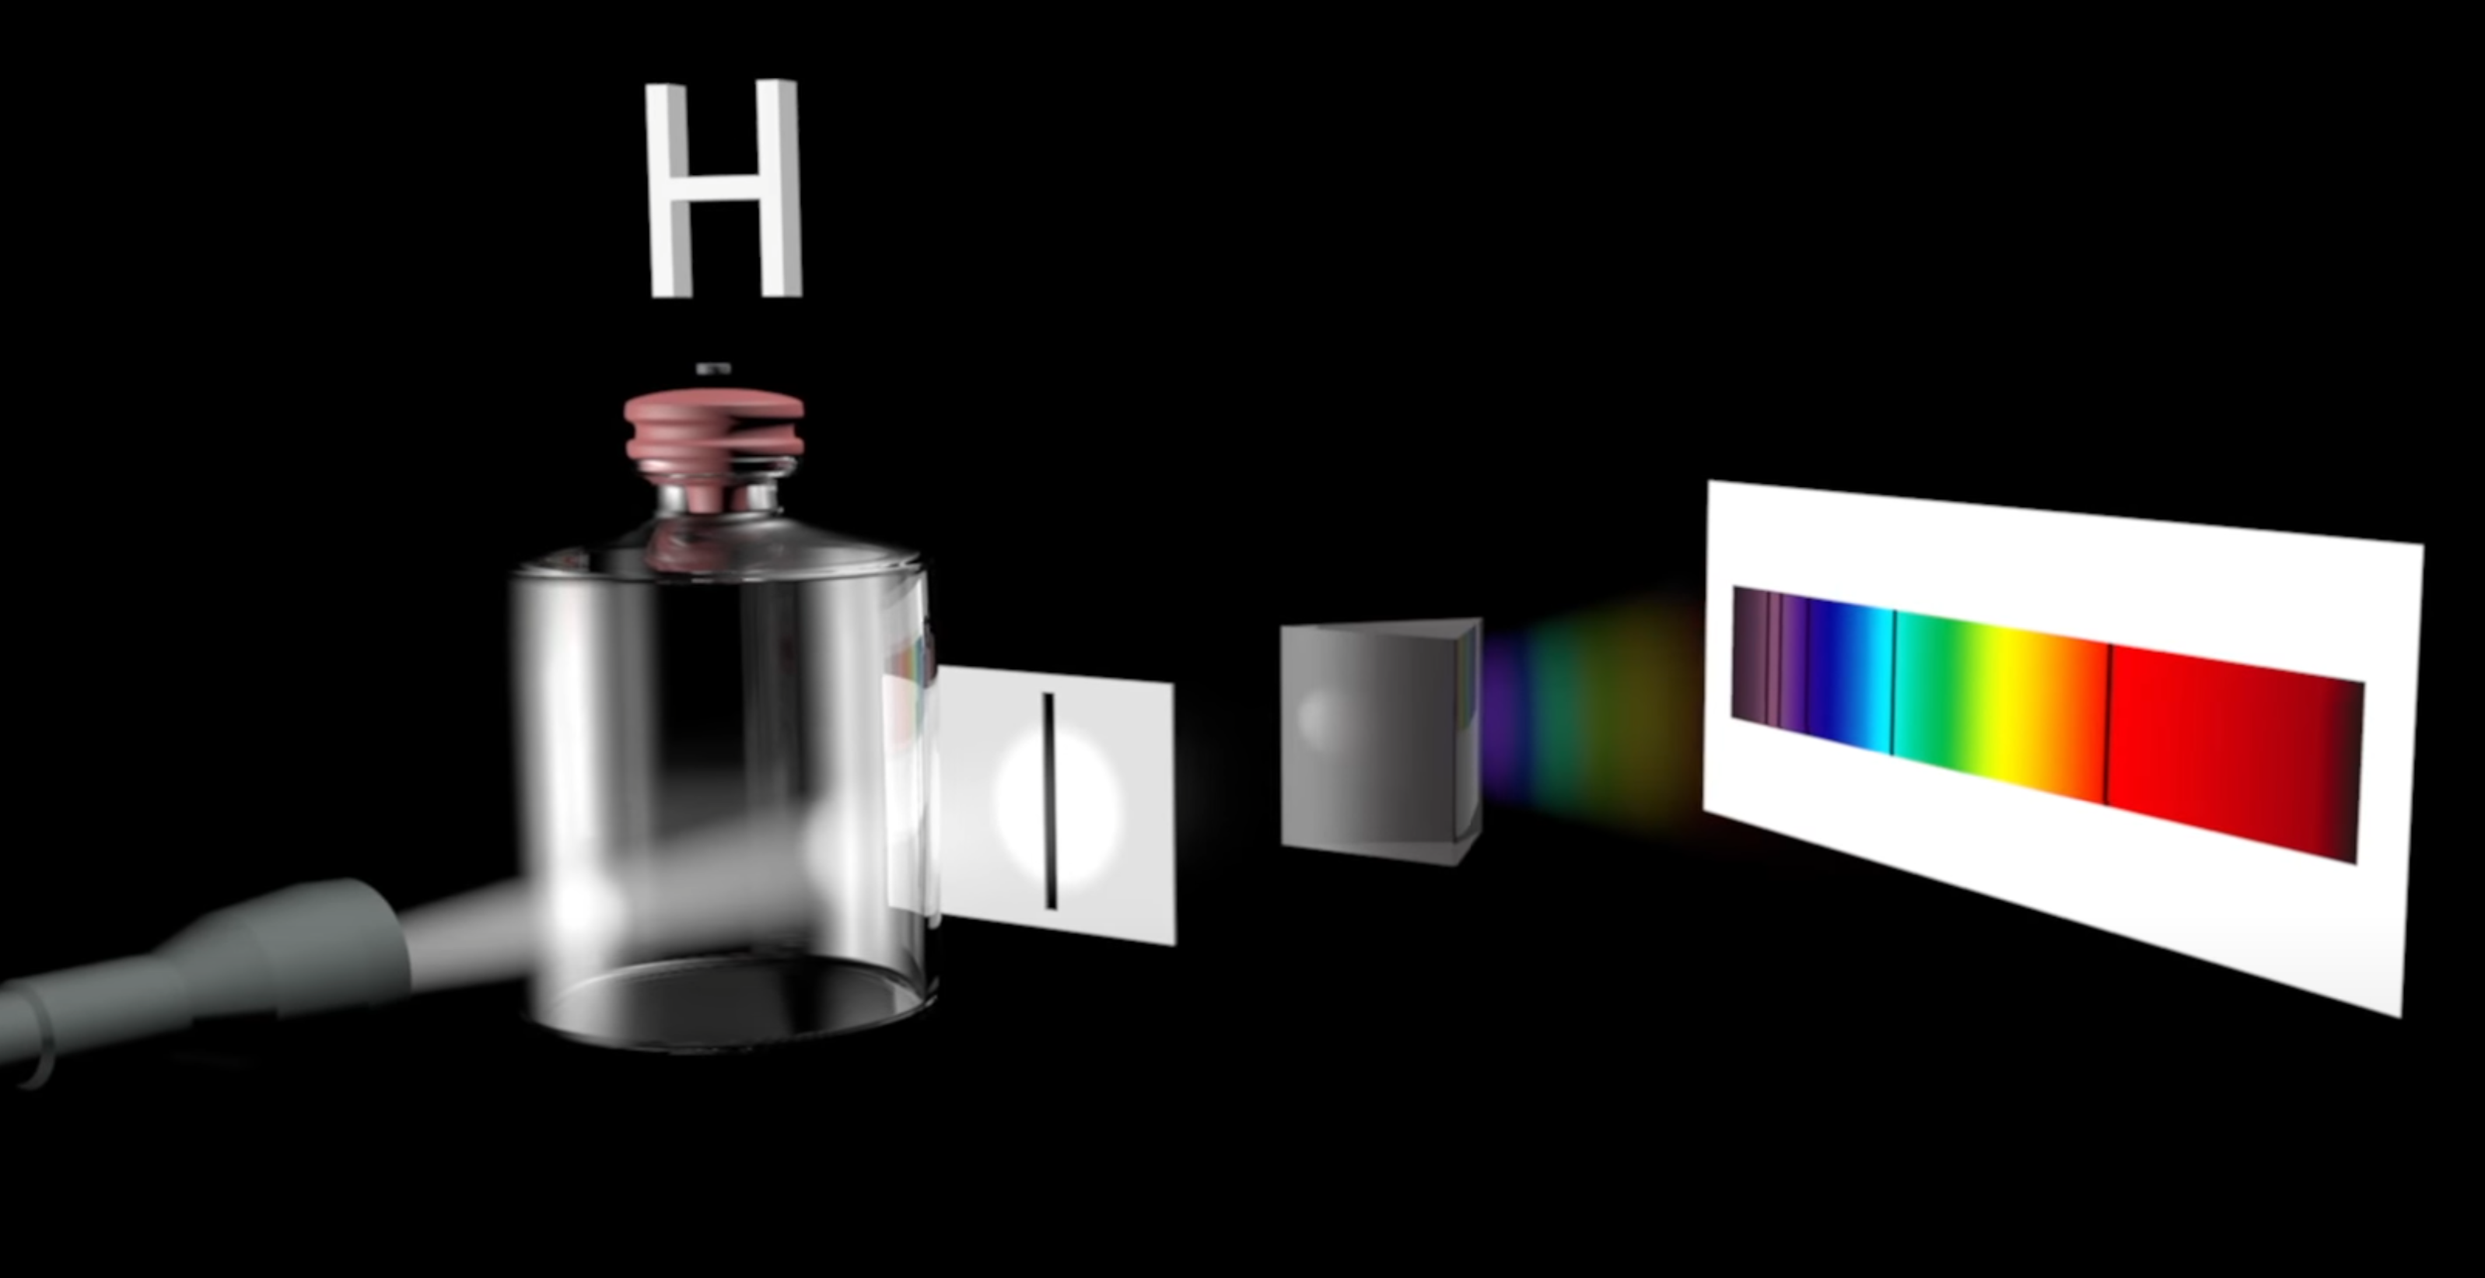
Spectroscopy
ALHAMBRAsurvey
Notes:
PRESENTATION NOTES
The video is really short (1 min) if you want to watch it and has a bit of history at the start.
Explain the process of spectroscopy – most students will be familiar with prisms.
Some spectrometers have diffraction gratings.
SCIENCE NOTES
b ≈ 2898 μm⋅K, b is Wien’s displacement constant.
The absorption spectrum for Hydrogen is shown.
In large spectrometers a plate is placed on the telescope where a camera would normally go. The plate has holes in over the positions of stars and optical fibres go in the holes and feed starlight down the a cooled spectrometer in another room (see SDSS plates).
Image from: https://www.youtube.com/watch?app=desktop&v=g_M4cgdjjrI

Slide 14
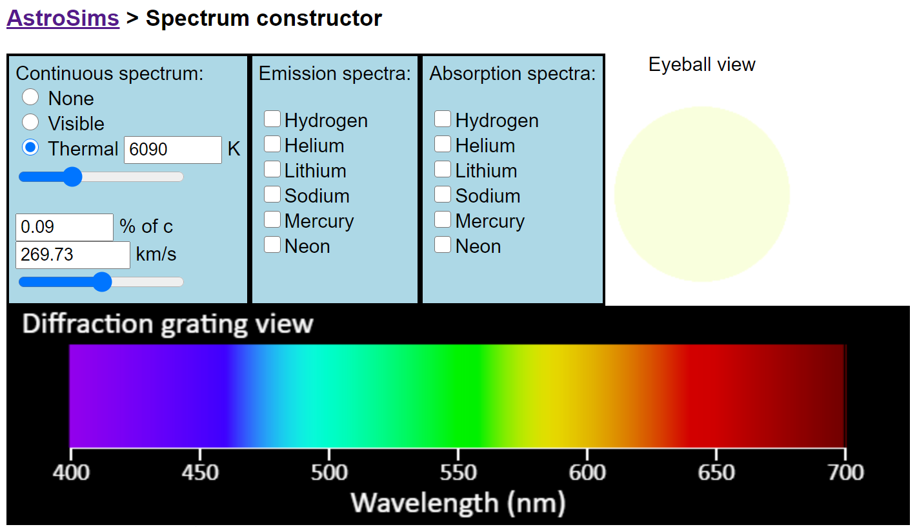
Notes:
PRESENTATION NOTES
https://foothillastrosims.github.io/Spectrum-Constructor/
Use the simulation to demonstrate how the spectra we get from the telescope (below the continuum - not shown on this slide) changes when the temp of the star changes using the thermal slider.
Then add in some absorption spectra – start with Hydrogen.
SCIENCE NOTES
When more than one element is present causing dips in the spectra we compare the dips to known reference spectra to see if they match what we should see if there was only one element present.
Image from: https://foothillastrosims.github.io/Spectrum-Constructor/

Slide 15
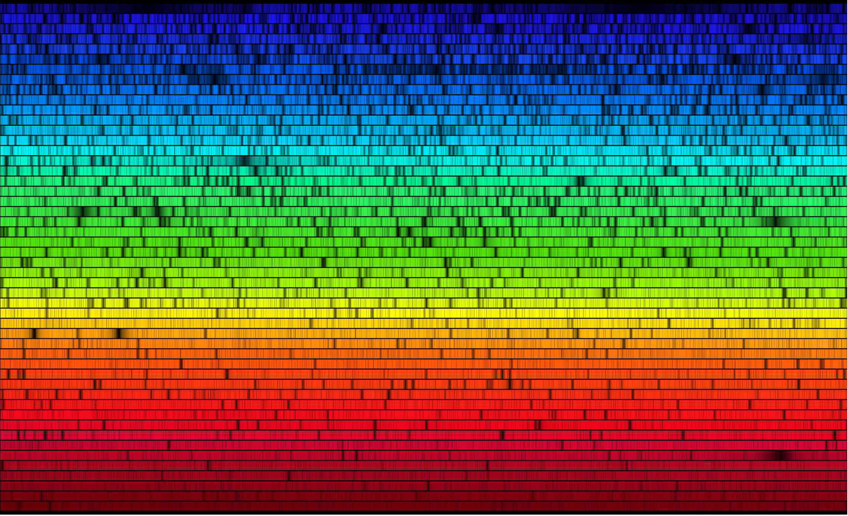
N.A.Sharp, NOAO/NSO/Kitt Peak FTS/AURA/NSF
Notes:
PRESENTATION NOTES
Spectrum of the Sun
“The first evidence of helium was observed on August 18, 1868, as a bright yellow line with a wavelength of 587.49 nanometres in the spectrum of the chromosphere of the Sun. The line was detected by French astronomer Jules Janssen during a total solar eclipse in Guntur, India.” Wikipedia - Helium
SCIENCE NOTES
See the link below for more info.
Image from: https://www.cfa.harvard.edu/ssp/stars_planets/solarspectrum.html
N.A.Sharp, NOAO/NSO/Kitt Peak FTS/AURA/NSF

Slide 16
Recap
What is the difference between an absorption and emission spectrum?
How do we get the spectra of stars?
What does a hot object emit?
Describe a perfect blackbody.
Notes:
RECAP
Spend 4-5 minutes recapping. Have students answer the questions in TPS format.
Emission is black with coloured lines showing wavelengths that are emitted. Absorption is rainbow with black lines where wavelengths are absorbed.
Using spectrometers attached to telescopes (or in another room so they can be cooled and light is fed via optical fibres)
EM Radiation! The hotter the higher energy – we emit IR at body temp
An object which absorbs all incident radiation and emits all wavelengths

Slide 17
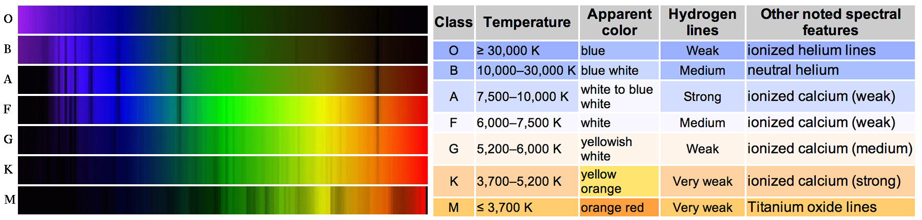
Spectral Type
OBAFGKMLTY
Orion Battles across Far Galaxies Killing Martians
writescience
Notes:
PRESENTATION NOTES
The left hand side is presented again later so focus on the order OBAFGKMLTY and the right hand side.
We normally ignore LTY.
SCIENCE NOTES
LTY are dwarf stars, Y can be colder than the human body and were discovered for the first time by the WISE spacecraft.
Image from: https://writescience.wordpress.com/tag/spectra/

Slide 18
Mnemonic Contest
OBAFGKMLTY
Orion Battles across Far Galaxies Killing Martians
Come up with a mnemonic to remember the sequence of spectral classes
Must be in English
Must be suitable for work
Extra points for the whole sequence (with LTY)
Prizes for best entries
Notes:
PRESENTATION NOTES
Other mnemonics: Oil, butter and fat gonna kill me
Only brilliant astronomers find gorilla killing meteors
Stolen from: http://www.astro.sunysb.edu/fwalter/AST101/mnemonic.html

Slide 19
Spectral Type
OBAFGKMLTY
writescience
Notes:
PRESENTATION NOTES
You can clearly see that going M to O (increasing Temp) you shift towards blue which are lower wavelengths with more energy.
SCIENCE NOTES
The Sun is a G2V star. 2 means it is on the hotter end of the G type stars. V means it is on the main sequence (main part of its life).
Image from: https://writescience.wordpress.com/tag/spectra/

Slide 20
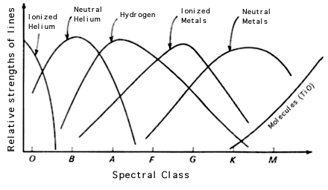
Spectral Type
P Crowther
Notes:
PRESENTATION NOTES
A little deep for most but this helps explain that KM stars are cold enough for molecules to form/stay as molecules.
In the hotter stars you can only have elements.
Too hot and you end up ionising elements like H and He.
SCIENCE NOTES
Molecules can’t survive the high temperatures in hotter stars so those lines disappear from stars in the OBAFG(K) classes.
Image from: http://www.star.ucl.ac.uk/~pac/spectral_classification.html

Slide 21
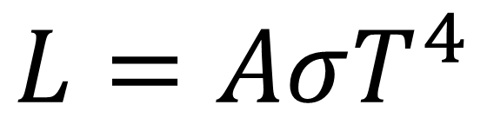
Luminosity
$$L=AσT^{4}$$
Luminosity, L is measured in Watts (W). Think of it as the Power of the star.
A is the surface area of the star in m²
σ is the Stefan-Boltzmann Constant, 5.67 Wm⁻²K⁻⁴
T is the temperature in Kelvin (K)
Notes:
PRESENTATION NOTES
Students in the UK will have come across Power so frame it as Luminosity is the Power of the star.
SCIENCE NOTES
This is the Stefan-Boltzmann equation and is missing a term called the emissivity. We have assumed it is 1 which means our star is a perfect blackbody: https://en.wikipedia.org/wiki/Stefan%E2%80%93Boltzmann_law
The luminosity of the Sun is 3.83×10²⁶ W if we ignore neutrinos.

Slide 22
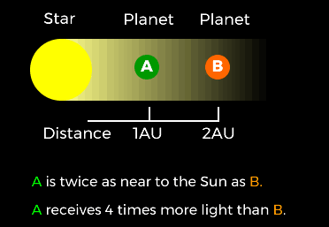
Inverse-square law
The further away from a light emitting object the less light you receive.
If you double the distance you receive four times less light.
space.fm
Notes:
PRESENTATION NOTES
Link to gravitational field strength.
SCIENCE NOTES
Here AU is the astronomical unit. The Earth is 1 AU from the Sun so A might be Earth!
Image from: https://www.space.fm/astronomy/planetarysystems/gravityandinverse.html

Slide 23
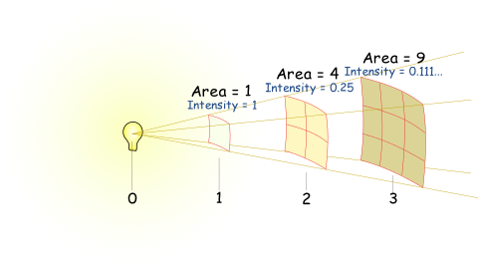
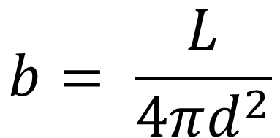
Inverse-square law
The brightness (intensity) of light is given by:
It has units of Wm⁻².
d is the distance you are from the star.
$$b= \frac{L}{4πd^{2}}$$
mathsisfun
Notes:
PRESENTATION NOTES
Intensity and brightness are interchangeable.
SCIENCE NOTES
The denominator is the surface area of a sphere since light is radiated spherically in all directions from the Sun and other stars.
The brightness or solar radiation at Earth is ~ 1,400 Wm⁻².
On Mars this value is ~715 Wm⁻² (max values taken).
Image from: https://www.mathsisfun.com/physics/radiation.html

Slide 24
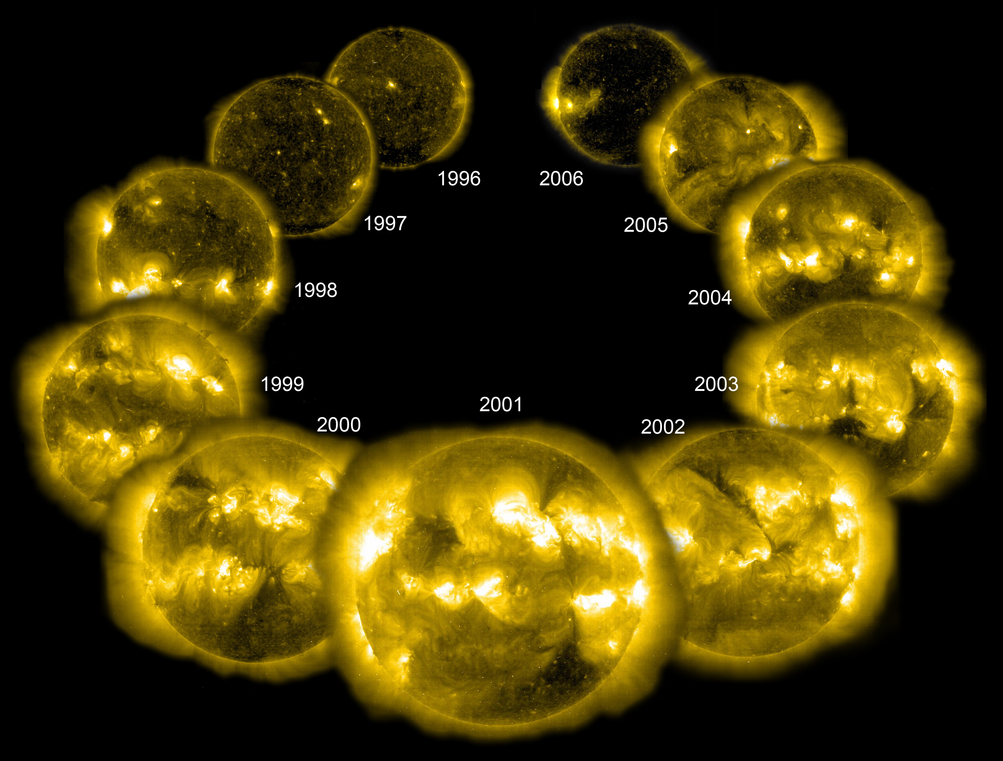
Steele Hill, SOHO, NASA/ESA
Notes:
PRESENTATION NOTES
Link to what students already know about the solar cycle. Question them:
What wavelength is this?
What do the bright spots show?
How long is the solar cycle?
SCIENCE NOTES
Total Solar Irradiance (TSI) varies by ~0.1 % during a solar cycle
Over the Sun’s lifetime it’s power has increased by 30 %
“This is an inevitable evolution which comes about because, as the billions of years roll by, the Sun is burning up the hydrogen in its core. The helium "ashes" left behind are denser than hydrogen, so the hydrogen/helium mix in the Sun's core is very slowly becoming denser, thus raising the pressure. This causes the nuclear reactions to run a little hotter. The Sun brightens.” - https://faculty.wcas.northwestern.edu/~infocom/The%20Website/evolution.html
Image from: https://www.nasa.gov/mission_pages/Glory/solar_irradiance/total_solar_irradiance.html

Slide 25
Recap
What are the spectral types in order?
What spectral type is our Sun?
Describe the inverse square law for light.
How has the luminosity of the Sun changed?
Notes:
RECAP
Spend 4-5 minutes recapping the last lesson. Have students answer the questions in TPS format.
OBAFGKM(LTY)
G2V lower number is hotter in the class, V for typical main sequence
Doubling the distance from the light source decreases the brightness by a factor of 4
Increased by 30 % over its liftetime

Slide 26
Nuclear Fusion
Up next:
Notes:
PRESENTATION NOTES
The next PPT is on Nuclear Fusion

